Slide 1
API Automation Basics Date: 10.03.2023 Presenter: Arunava Mitra Topic: Karate & Rest-Assured Framework (API Automation)

Slide 2
Topics
Karate Testing Framework (API)
Introduction to API Automation
Significance of API Automation
Intro to Karate?
Intro to Rest-Assured?
Karate Vs Rest-Assured
Rest Assured:
Installation and Initial setup- Rest-Assured
Explanation of Folder Structure- Rest-Assured
Rest-Assured API Test Example
Writing and Executing Test cases - Rest-Assured
Test Reports- Rest-Assured
Karate:
Installation and Initial setup
Explanation of Folder Structure
Karate API Test Example
Writing and Executing Test cases
Test Reports
Which one to choose?
Question

Slide 3
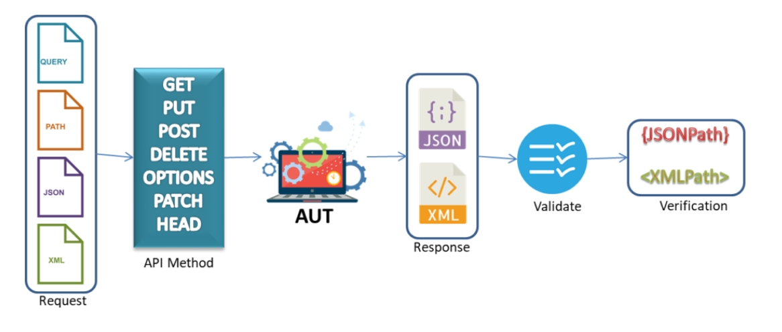
Introduction to API Automation
API Testing is a type of Software testing where the interface in between two applications be on same or different Technology
An API test is generally performed by making requests to one or more API endpoints and comparing the response with expected results.
API testing is frequently automated and used by DevOps, QA and development teams for continuous testing practices
There are many API automation tools in the market
Here are the 2 popular frameworks – Karate and Rest-Assured

Slide 4
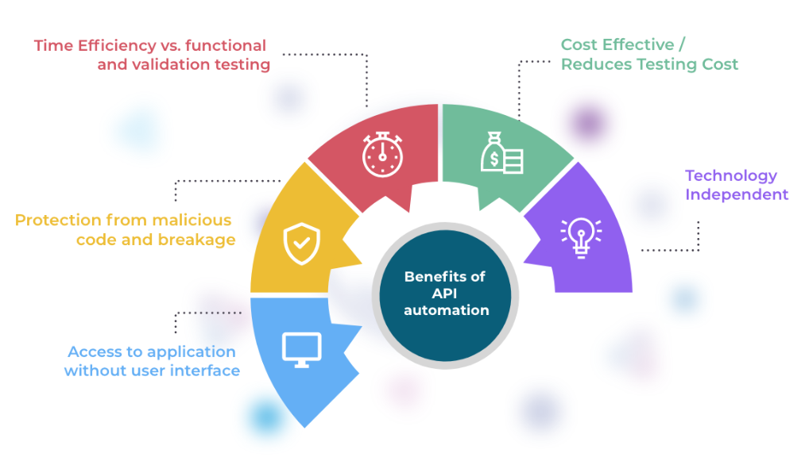
Significance of API Automation

Slide 5

Introduction to Rest-Assured
Rest-Assured is a Java-based library that is used to test RESTful Web Services.
This library behaves like a headless Client to access REST web services.
We can create highly customize-able HTTP Requests to send to the Restful server.
This enables us to test a wide variety of Request combinations and in turn test different combinations of core business logic.
Can use both BDD and non-BDD Syntax.
It was developed and maintained by Johan Haleby with the support of several other contributors.

Slide 6
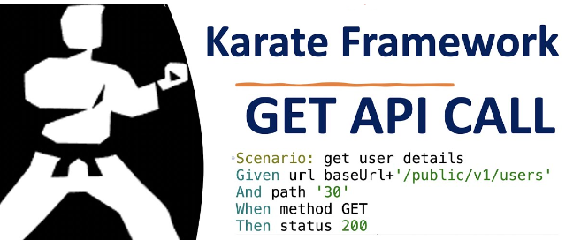
Introduction to Karate
Karate is an open-source tool to perform API test-automation.
Karate is implemented in Java but test-scripts are written in Gherkin since Karate was originally an extension of the Cucumber framework.
Can also do API performance-testing and even UI automation into a single, unified framework.
It is based on Cucumber and uses the Gherkin Syntax.
With the Karate framework, testers without a programming background can perform tests more easily.
Created By Peter Thomas on 2017.

Slide 7
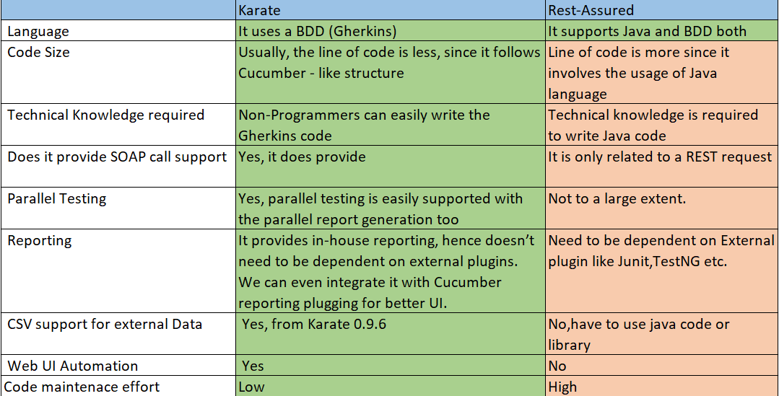

Karate Vs Rest-Assured

Slide 8
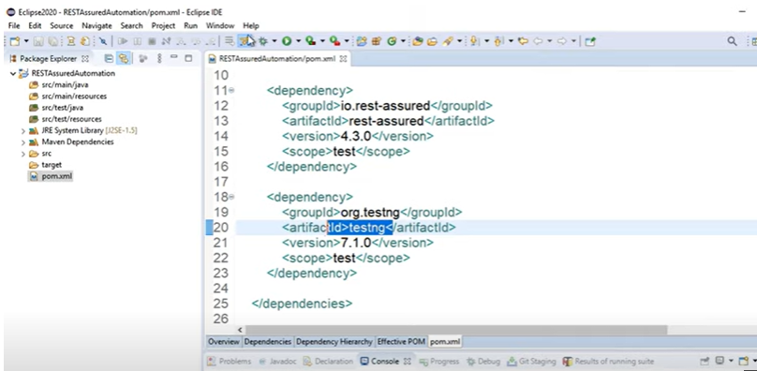
Installation and Initial Setup - RestAssured
Prerequisites - Java, IDE (Eclipse,InteliJ) ,Maven, TestNG
Karate project setup
Create a Maven Project
Add Dependencies to pom.xml – ‘io.rest-assured’ , ‘org.testing’
Check pom.xml

Slide 9
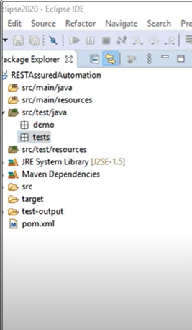
Rest-Assured project Structure
Rest-Assured project structure mostly consists of the following folders

Slide 10
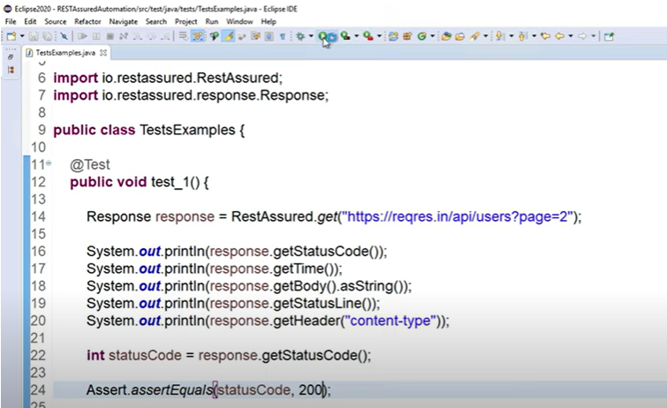
RestAssured Test Example

Slide 11
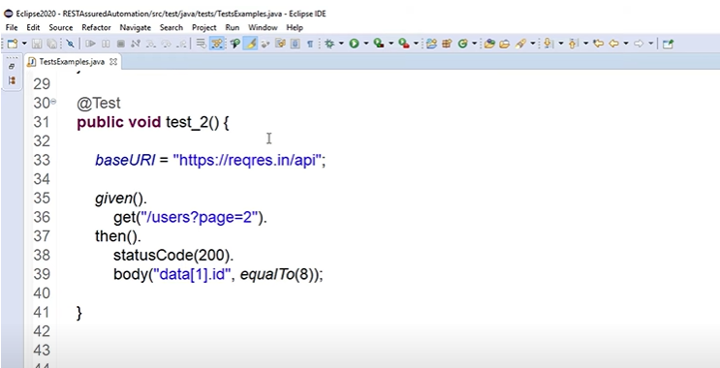
RestAssured Test Example – BDD Way

Slide 12
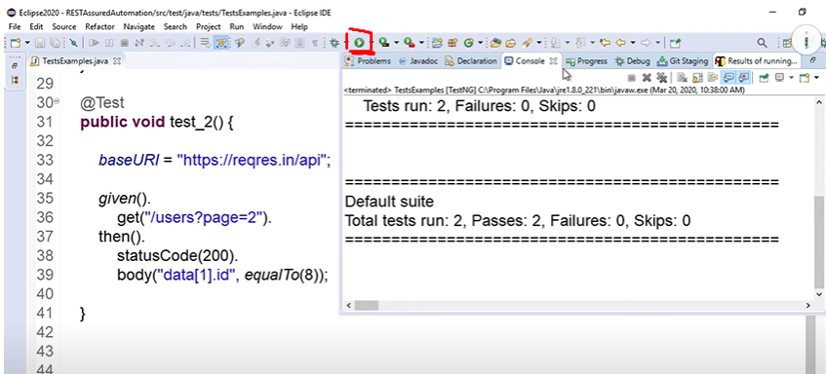
Executing Test cases using IDE- RestAssured

Slide 13
Executing Test cases using CMD -RestAssured
mvn test -D tags=" @tagname"

Slide 14
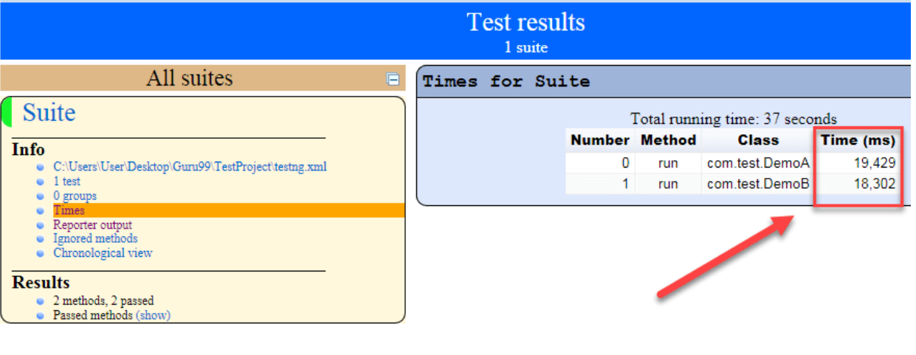
TestNG Report - RestAssured

Slide 15
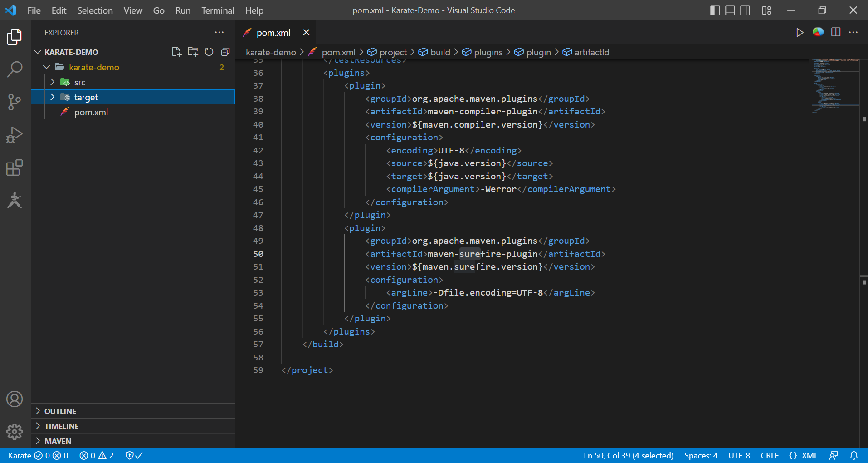
Installation and Initial Setup - Karate
Prerequisites - Java, IDE (Eclipse,InteliJ) ,Maven, TestNG
Karate project setup
Open CMD move to specific folder
Run command from ‘https://github.com/karatelabs/karate#quickstart’
Type ‘Code .’ and it will open that project in Visual code
Check pom.xml

Slide 16
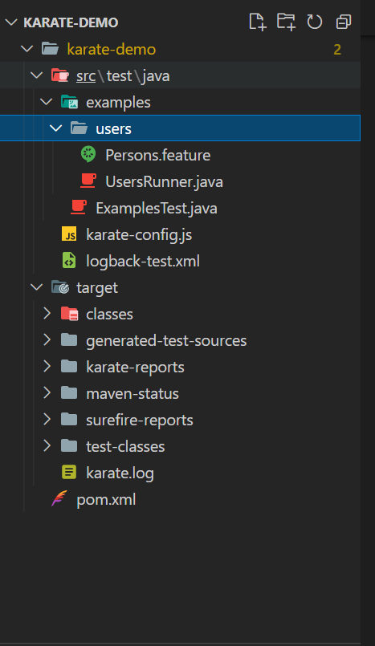
Karate project Structure
Karate project structure consists of the following folders

Slide 17
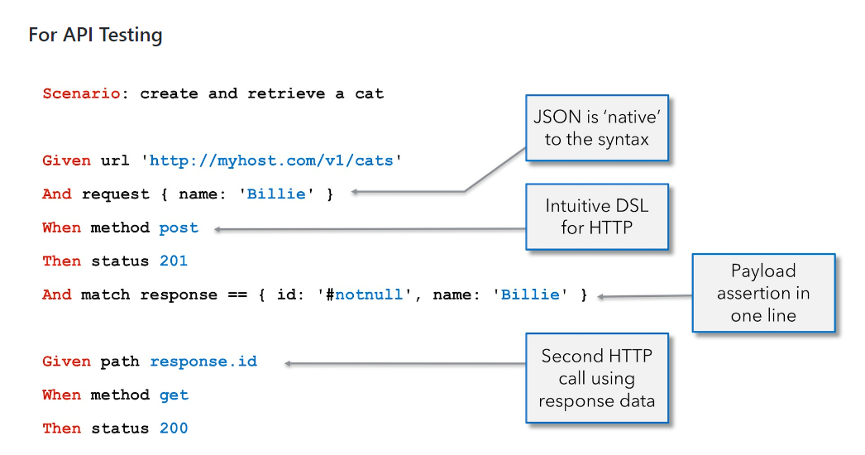
Karate Test Example

Slide 18
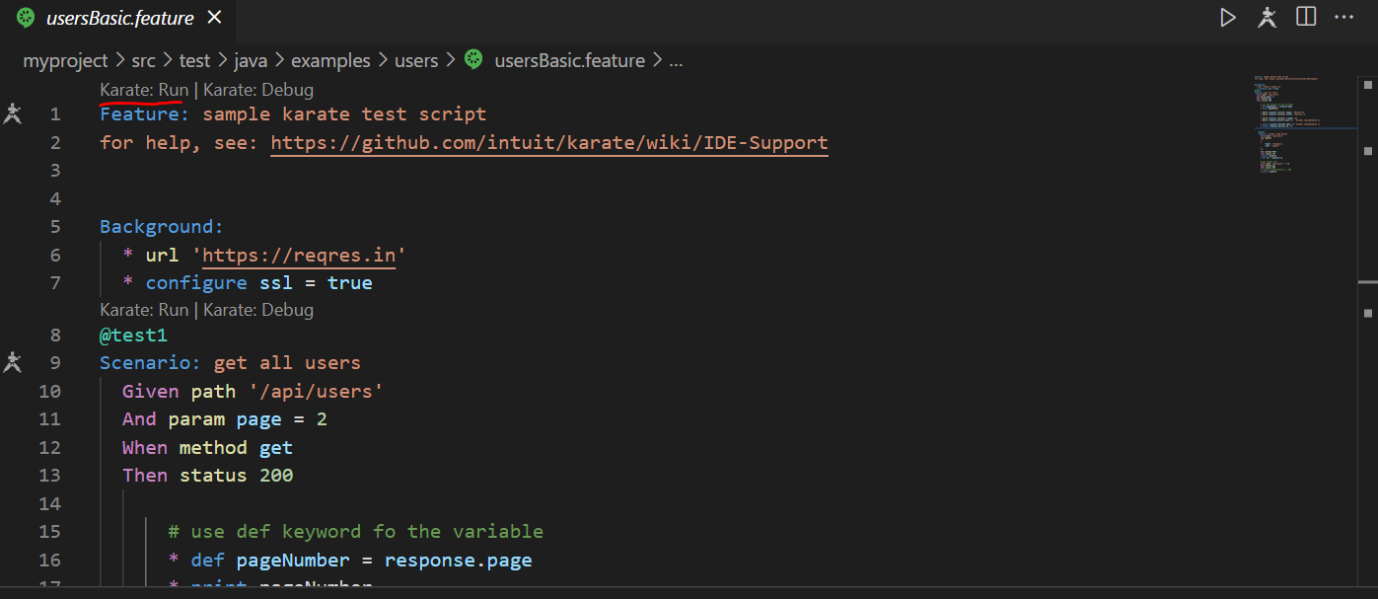
Executing Test cases using Test Runner Extension - Karate

Slide 19
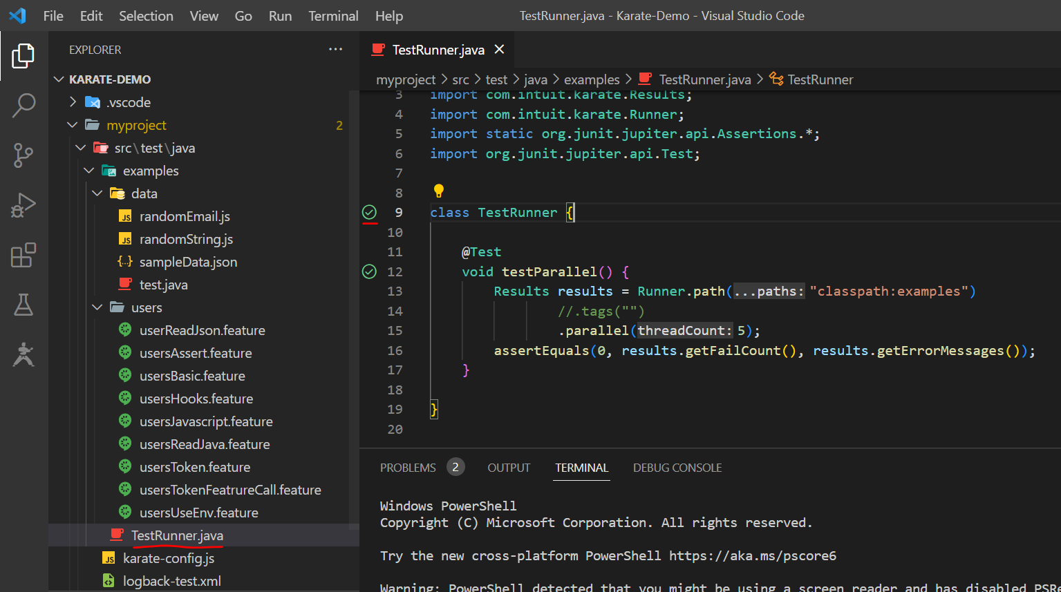
Executing Test cases using Runner.java - Karate

Slide 20
Executing Test cases using CMD - Karate
mvn clean test -D karate.env=qa -D karate.options="--tags @tagname"

Slide 21
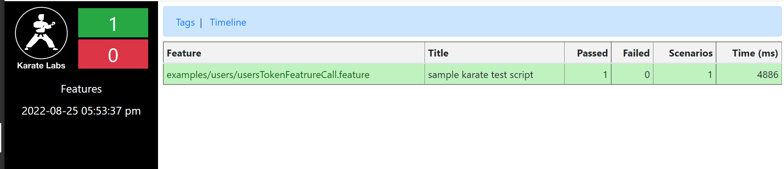
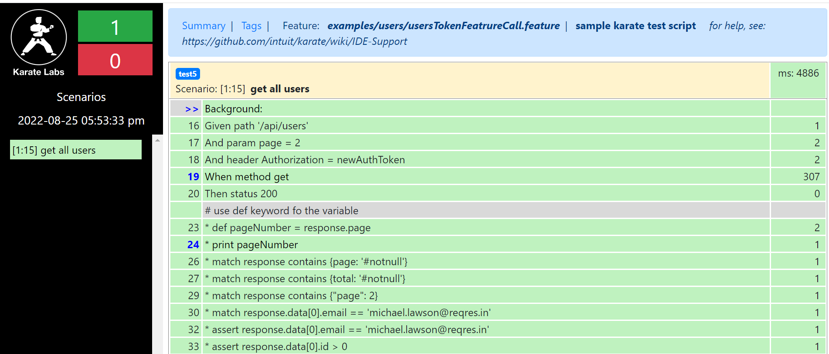
Reports - Karate

Slide 22
Which one to choose?
Which Is the Best API Testing Tool for You? It Depends.
Both API testing tools have strengths and weaknesses. Each can easily empower your team. Consider the following recommendations when selecting your tool.
Karate is recommended when:
• You want a quick start to do API tests, without a major hassle.
• Your team lacks a Java background, or wants to work with Gherkin.
• Your product owners are empowered in code and can write some tests in Gherkin.
• You’re comfortable enough with Karate’s standard reports and don’t want to spend the time creating enhanced reporting.
REST-Assured is recommended when:
• Your team has Java expertise.
• You want to give more responsibility for test creation to developers (improving the quality assurance methodology).
• You need or want to use the improved matchers offered by Hamcrest.
• You’re working with an API that requires intricate logic that is easier to write in Java.

Slide 23
Sources: https://www.google.com/ https://stackoverflow.com/ https://www.guru99.com/ https://www.youtube.com/ https://www.slideshare.net https://www.scribd.com/

Slide 24
Question?

